Slide 1
Index Compression Techniques
Dr. Bhuvaneswari A
VIT Chennai

Slide 2
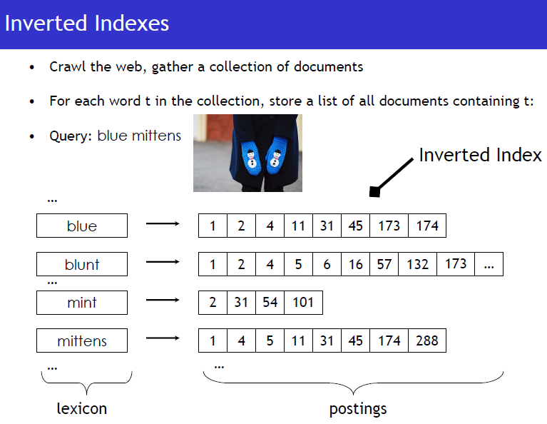

Slide 3
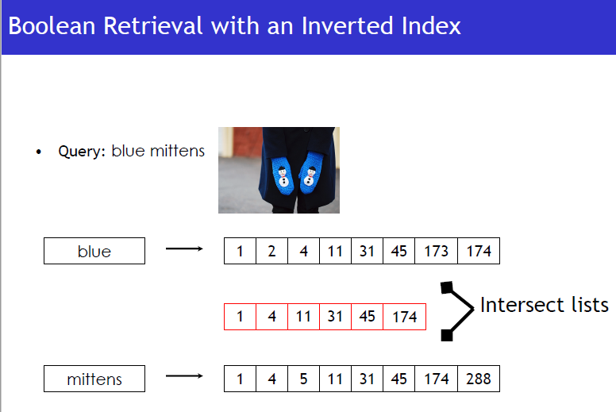

Slide 4
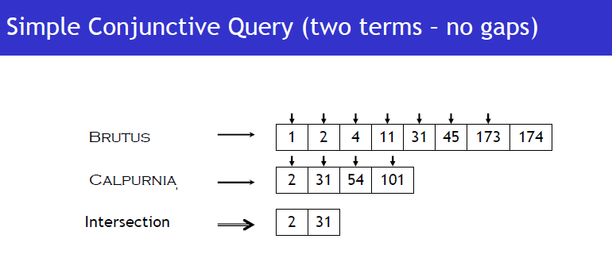

Slide 5
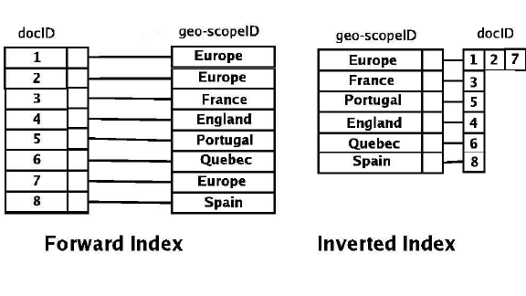

Slide 6
Structure and Construction
Structure (split the index into two files)
Vocabulary: O(n^{β}) according to Heaps’ Law
Occurrences : depends on the addressing granularity
Construction
The vocabulary is stored in lexicographical order and points to posting list.
Posting file：the lists of occurrences are stored contiguously

Slide 7
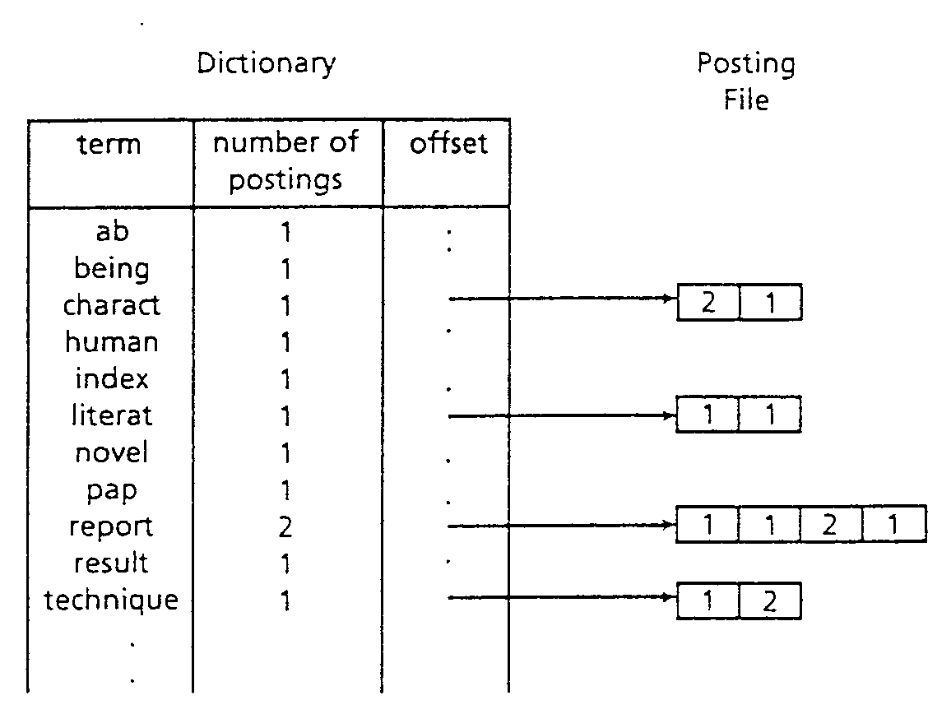
Dictionary and Postings File
(document #, frequency)

Slide 8
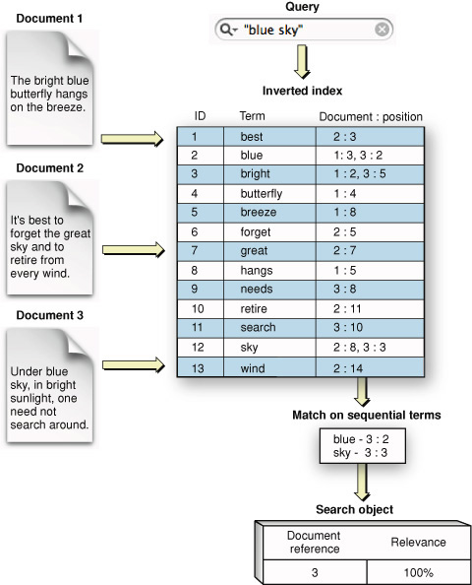
IInverted Index Query

Slide 9
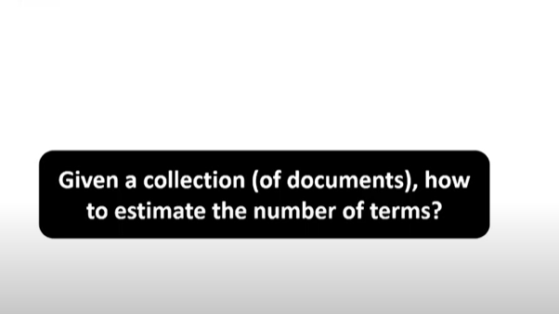

Slide 10
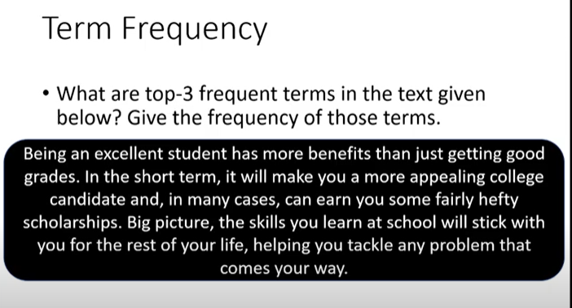

Slide 11
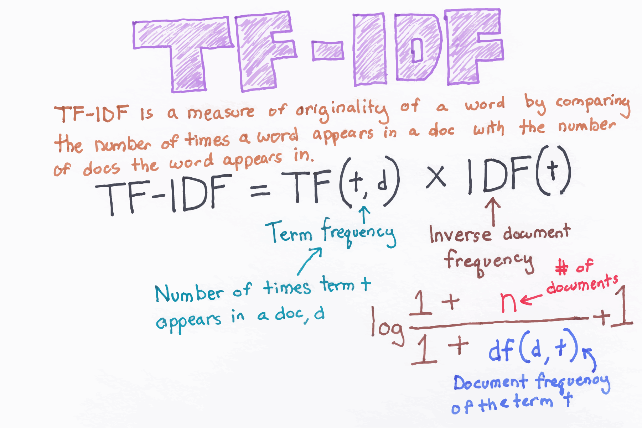

Slide 12
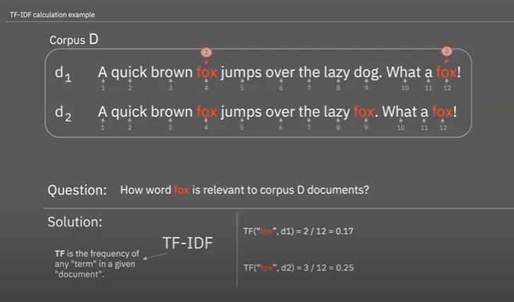

Slide 13
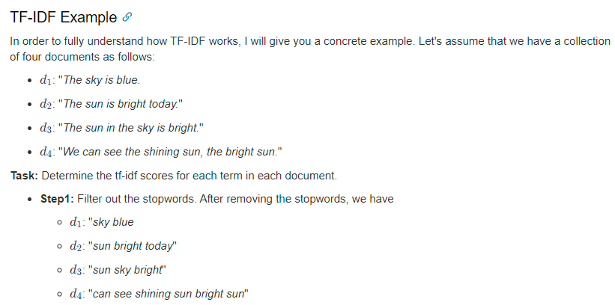

Slide 14
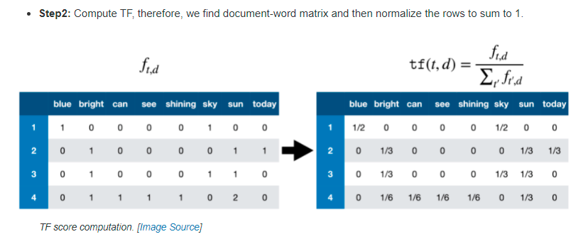
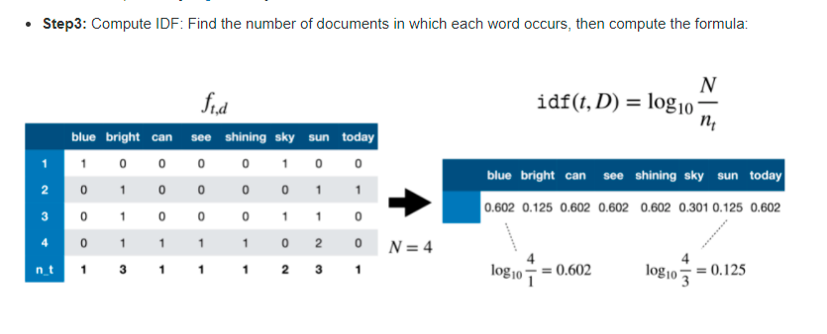

Slide 15
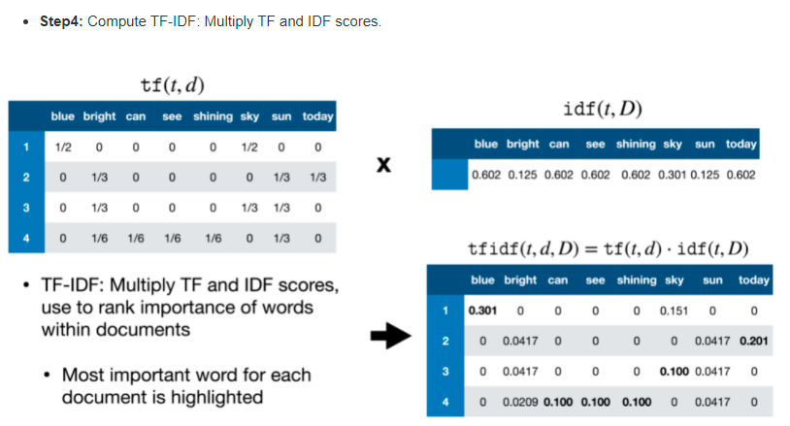

Slide 16
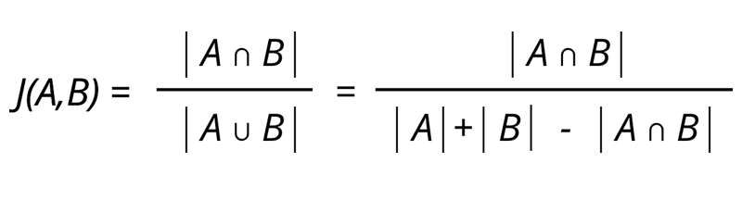
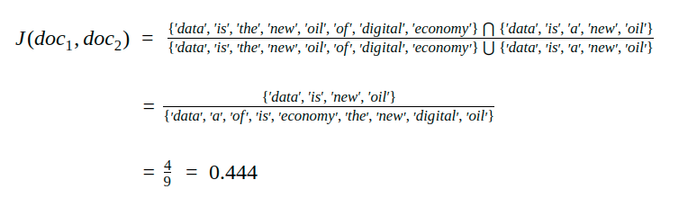
Jaccard Similarity

Slide 17
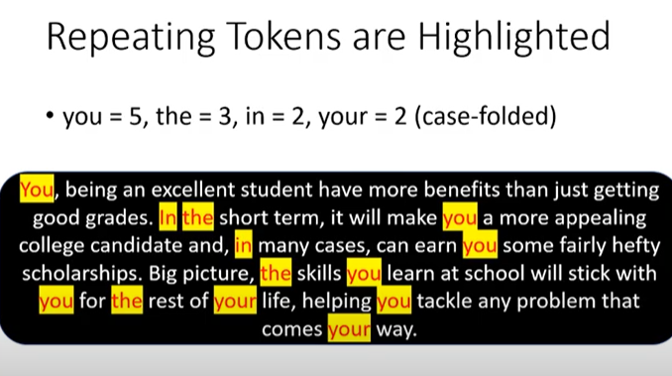

Slide 18
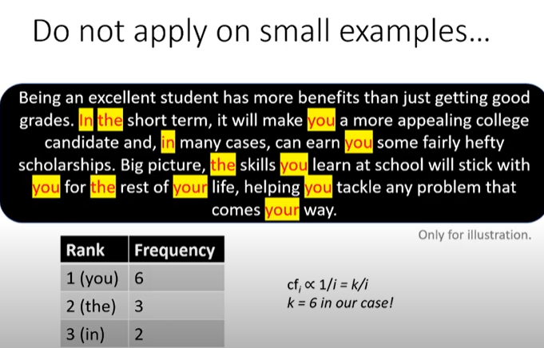

Slide 19
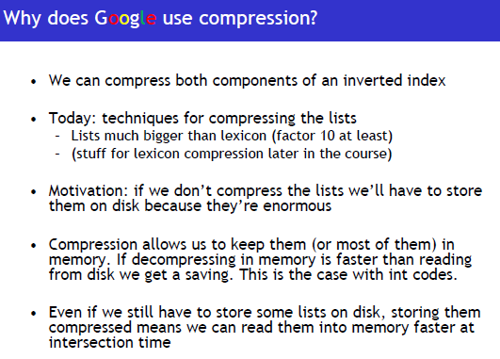

Slide 20
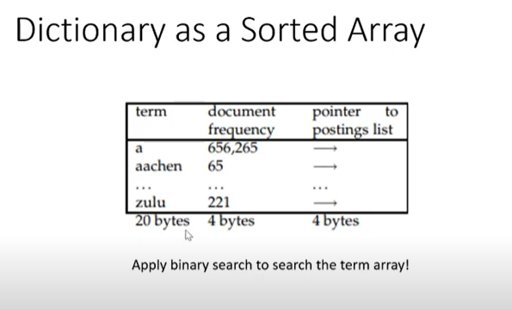
Compressing Dictionaries

Slide 21
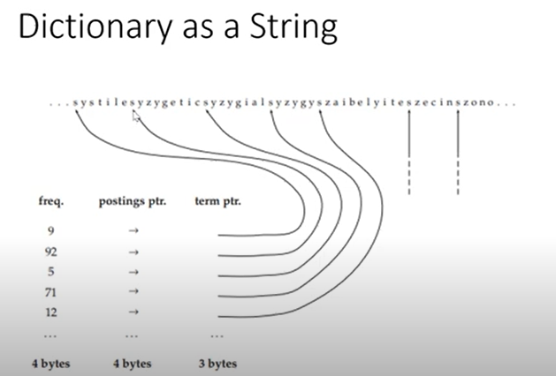

Slide 22
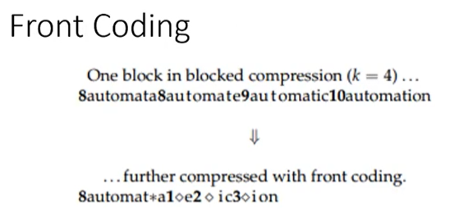

Slide 23
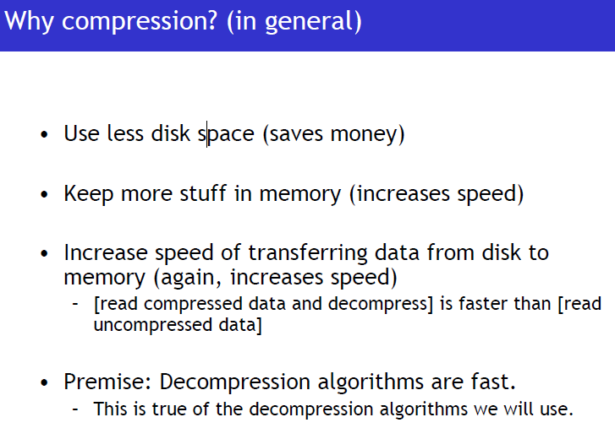

Slide 24
lossless compression
Main space used by an inverted index
storage of document IDs and offsets of each term
Integer compression
an integer has a fixed-size representation of four bytes (32 bits)
few integers need 4 bytes to represent

Slide 25
Compression Schemes
two classes of compression schemes for inverted lists
variable-bit (bitwise) scheme
an integer is represented with an integral number of bits
unary coding
Elias gamma coding
Elias delta coding
Golomb coding
variable-byte (bytewise) scheme
an integer is stored in an integral number of bytes

Slide 26
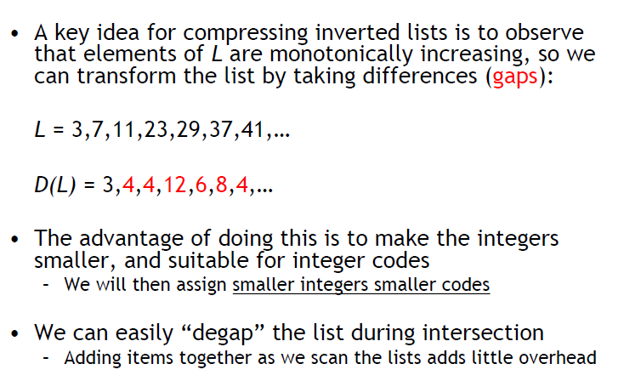
Compression Schemes

Slide 27
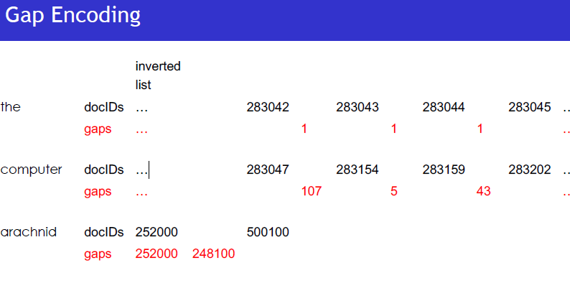

Slide 28
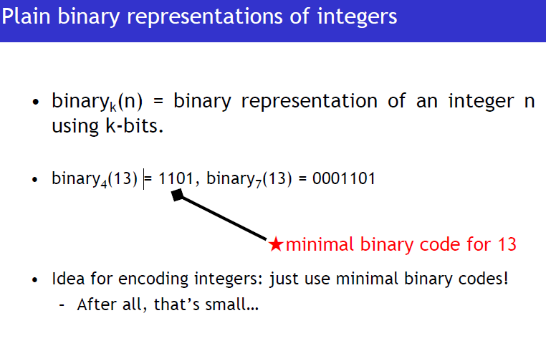

Slide 29
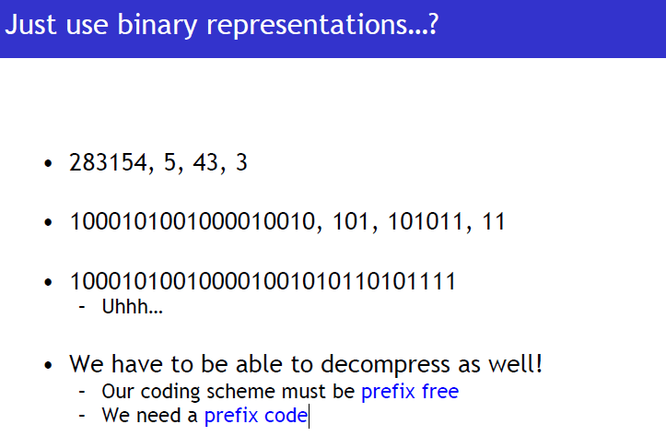

Slide 30
Unary Codes
Unary code also sometimes called thermometer code is a type of entropy encoding. It is a lossless data compression technique with application in Golomb codes.
Unary representation of a natural number n is n ones followed by a zero. For example, unary code for 6 will be 6 zeros followed by a one which is 000 0001

Slide 31
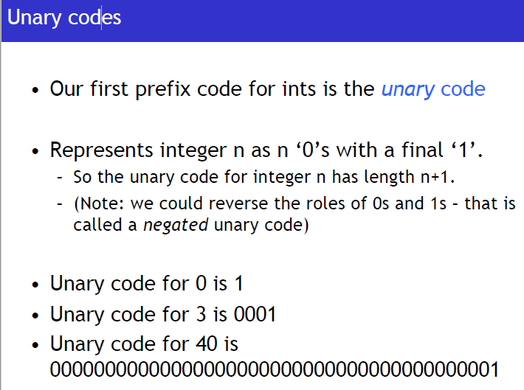

Slide 32
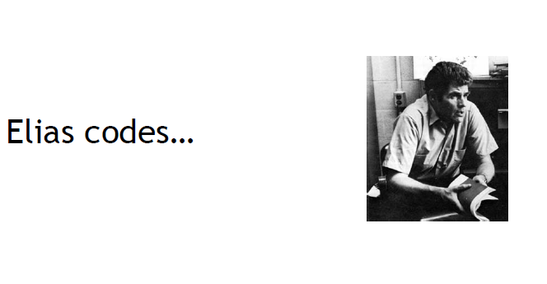

Slide 33
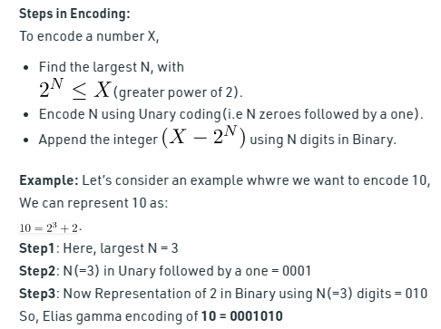
Elias Gamma Encoding
The Elias gamma code is a universal code that is used to encode a sequence of positive integers. It is developed by Peter Elias.
It is most useful when the upper-bound of integers cannot be determined beforehand.

Slide 34
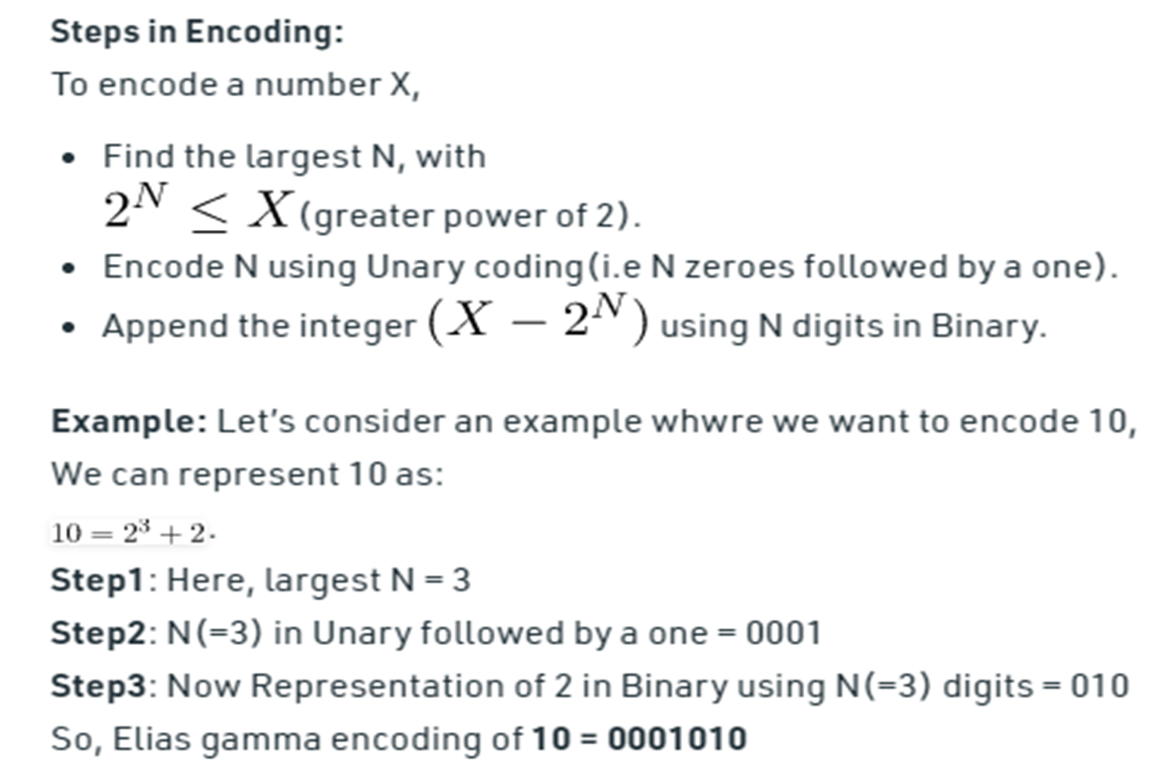

Slide 35
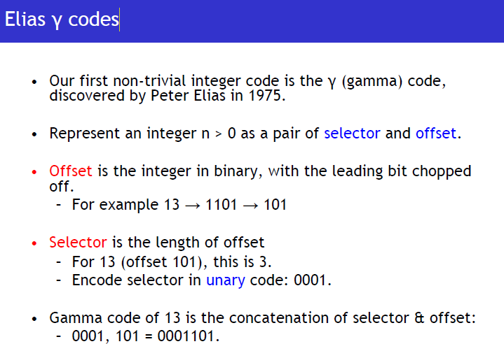

Slide 36
Gamma codes
Sec. 5.3
We can compress better with bit-level codes
The Gamma code is the best known of these.
Represent a gap G as a pair length and offset
offset is G in binary, with the leading bit cut off
For example 13 → 1101 → 101
length is the length of offset
For 13 (offset 101), this is 3.
We encode length with unary code: 1110.
Gamma code of 13 is the concatenation of length and offset: 1110101

Slide 37
Run Length Encoding
Given an input string, write a function that returns the Run Length Encoded string for the input string. For example, if the input string is “wwwwaaadexxxxxx”, then the function should return “w4a3d1e1x6”

Slide 38
Run Length Encoding
a) Pick the first character from the source string. b) Append the picked character to the destination string. c) Count the number of subsequent occurrences of the picked character and append the count to the destination string. d) Pick the next character and repeat steps b) c) and d) if the end of the string is NOT reached.

Slide 39
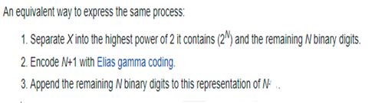
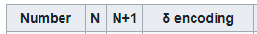
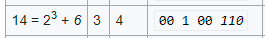
Elias Delta Coding

Slide 40
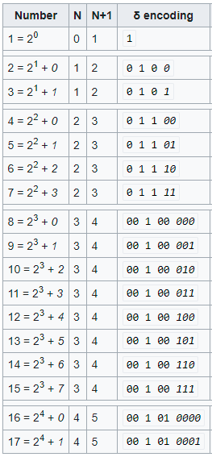
Elias Delta Coding

Slide 41
To decode an Elias delta-coded integer
Read and count zeros from the stream until you reach the first one. Call this count of zeros L.
Considering the one that was reached to be the first digit of an integer, with a value of 2^{L}, read the remaining L digits of the integer. Call this integer N+1, and subtract one to get N.
Put a one in the first place of our final output, representing the value 2^{N}.
Read and append the following N digits.

Slide 42
Example: 001010011
1. 2 leading zeros in 001
2. read 2 more bits i.e. 00101
3. decode N+1 = 00101 = 5
4. get N = 5 − 1 = 4 remaining bits for the complete code i.e. '0011'
5. encoded number = 2⁴ + 3 = 19

Slide 43
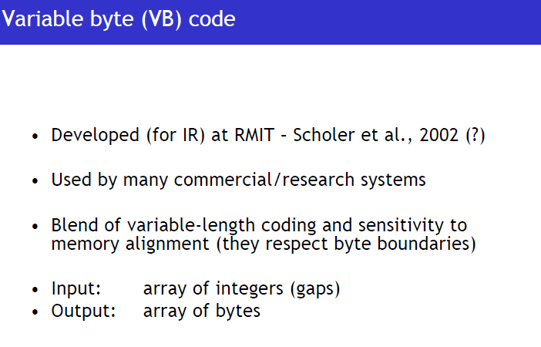

Slide 44
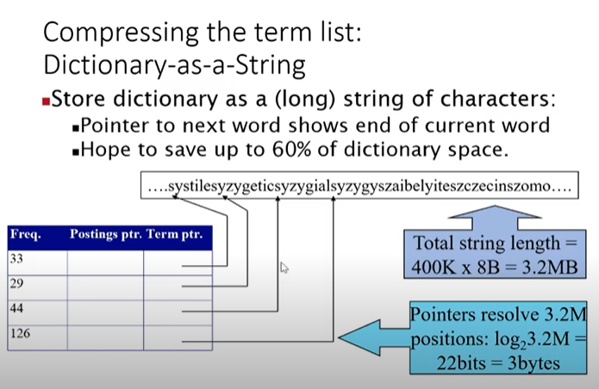

Slide 45
Store Gaps
interesting feature of the inverted index makes compression even more effective
store the difference between any two adjacent document IDs, idi and idi+1, where idi+1> idi, instead of the actual IDs
This difference is called the gap between idi and idi+1
The gap is a smaller number than idi+1 and thus requires fewer bits

Slide 46
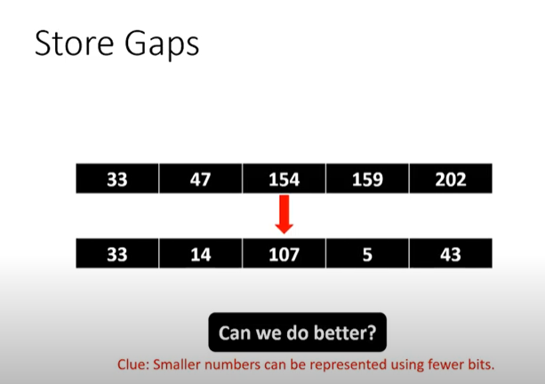

Slide 47
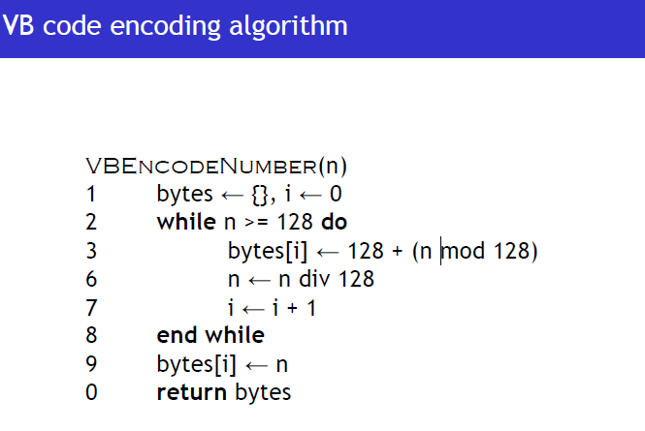

Slide 48
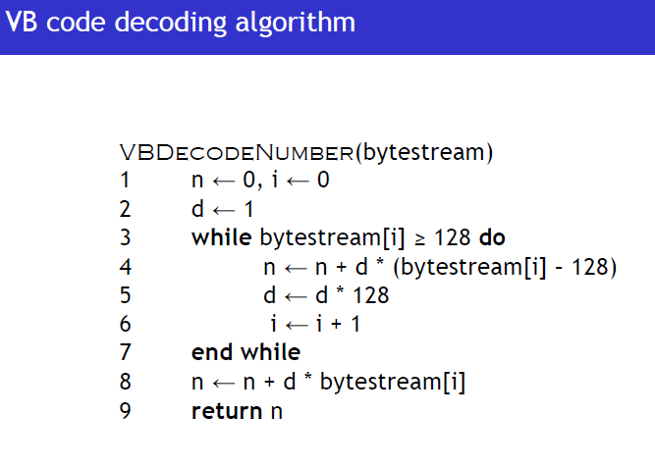

Slide 49
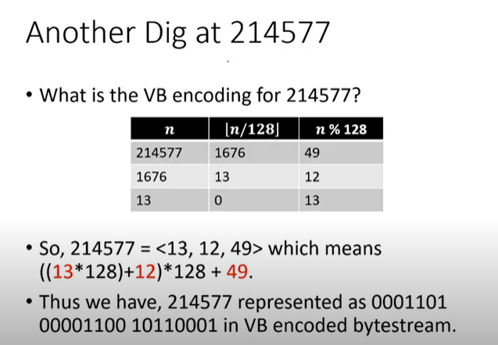

Slide 50
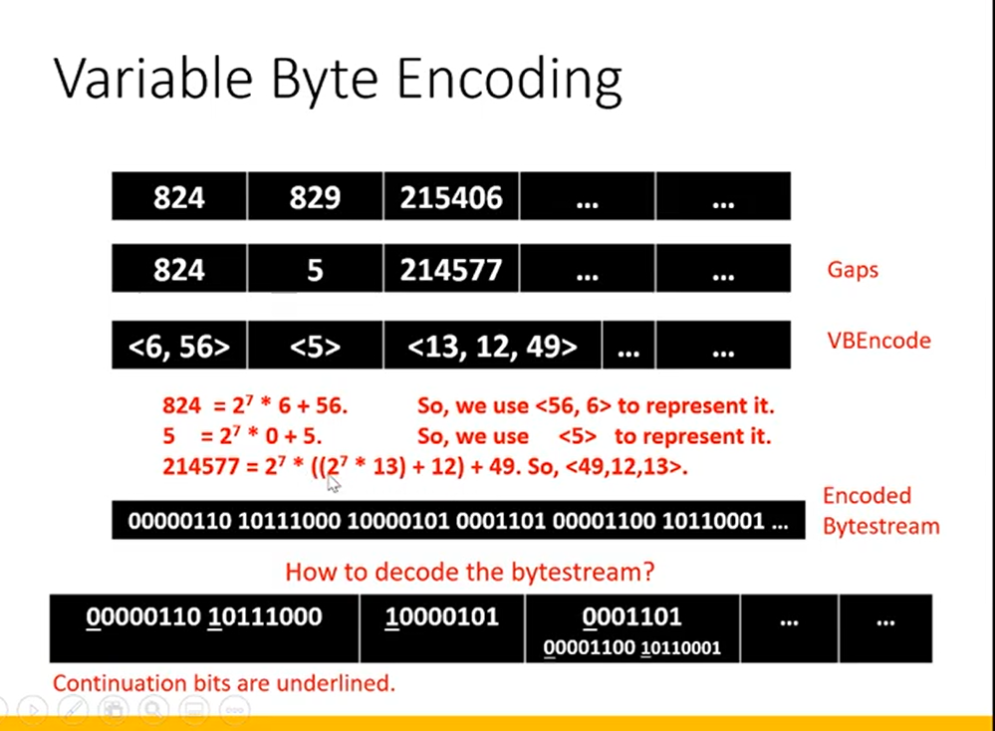

Slide 51
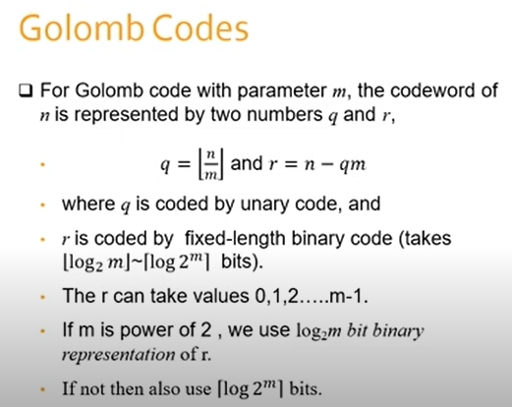

Slide 52
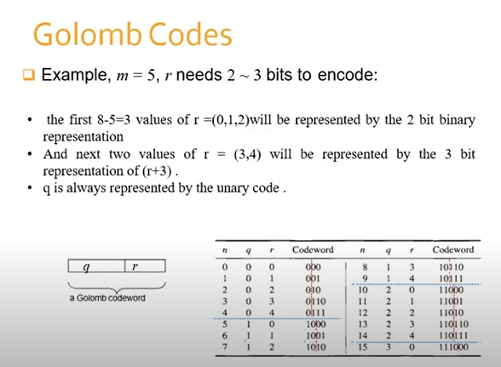

Slide 53
Golomb Coding
Elias codes yield acceptable compression and fast decoding, a better performance in both aspects is possible with the Golomb coding
A positive integer x is represented in two parts:
The first part is a unary representation of q+1, where q is the quotient [floor((x/b))]
The second part is a special binary representation of the remainder r = x - qb. Note that there are b possible remainders. For example, if b = 3, the possible remainders will be 0, 1, and 2.

Slide 54
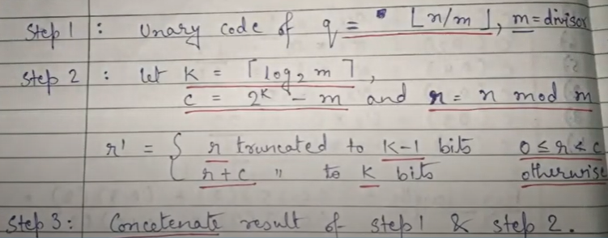
Golomb Coding

Slide 55
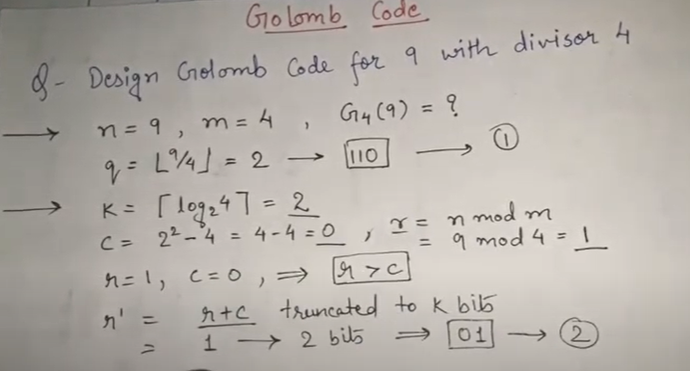
Example

Slide 57
Indexing and Searching
Modern Information Retrieval (Chapter 8) With G. Navarro

Slide 58
File Struces
Inverted Files
Signatures
PAT Trees
Sequential Searching
Compression

Slide 59
Inverted Files
Information Retrieval: Data Structures and Algorithms
(Chapters 3)
W.B. Frakes and R. Baeza-Yates (Eds.) 1992.

Slide 60
Inverted Files
Characteristics
A word-oriented mechanism based on sorted list of keywords, with each keyword having links to the documents containing that keyword.
Preprocessing
Each document is assigned a list of keywords or attributes.
Each keyword (attribute) is associated with relevance weights.

Slide 61
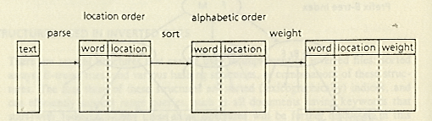
Inversion of Word List
1. The input text is parsed into a list of words along with their
location in the text. (time and storage consuming operation)
2. This list is inverted from a list of terms in location order to
a list of terms in alphabetical order.
3. Add term weights, or reorganize or compress the files.

Slide 62
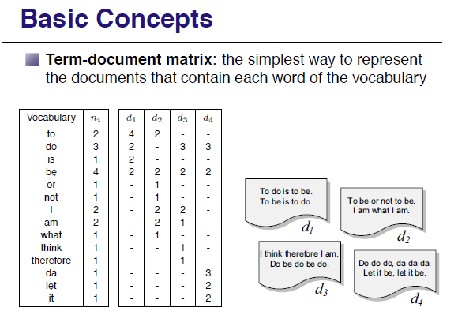

Slide 63
Structure and Construction
Structure (split the index into two files)
Vocabulary: O(n^{β}) according to Heaps’ Law
Occurrences : depends on the addressing granularity
Construction
The vocabulary is stored in lexicographical order and points to posting list.
Posting file：the lists of occurrences are stored contiguously

Slide 64
Dictionary and Postings File
(document #, frequency)

Slide 65
Structures used in Inverted Files
Vocabulary
Sorted Arrays
Hashing Structures
Keyword Trees: Tries (digital search trees)
The Search Procedure
Vocabulary search
Retrieval of occurrences
Manipulation of occurrences

Slide 66
Cost
Advantage
easy to implement
Disadvantage
updating the index is expensive

Slide 67
Signature Files
Information Retrieval: Data Structures and Algorithms

Slide 68
Signature Files
Characteristics
Word-oriented index structures based on hashing
Low overhead (10%~20% over the text size) at the cost of forcing a sequential search over the index
Suitable for not very large texts
Inverted files outperform signature files for most applications

Slide 69
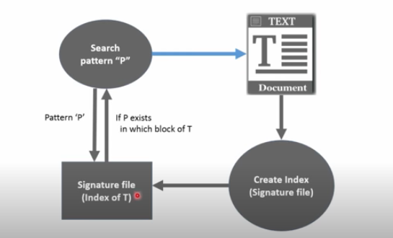

Slide 70
Construction and Search
Word-oriented index structures base on hashing
Maps words to bit masks of B bits
Divides the text in blocks of b words each
The mask is obtained by bitwise ORing the signatures of all the words in the text block.
Search
Hash the query to a bit mask W
If W & Bi = W, the text block may contain the word

Slide 71
Example
Four blocks:
This is a text. A text has many words. Words are made from letters.
000101 110101 100100 101101
Hash(text) = 000101
Hash(many)= 110000
Hash(words)= 100100
Hash(made)= 001100
Hash(letters)= 100001
Block 4: 001100
OR 100001
101101

Slide 72


Slide 73


Slide 74
False Drop
Assumes that m bits are randomly set in the mask
Let α=m/B
For b words, the probability that a given bit of the mask is set is 1-(1-1/B)^{bm} ≈1-e^{-bα}
Hence, the probability that the l random bits are also set is F_{d} =(1-e^{-bα})^{αΒ ←} False alarm
F_{d} is minimized for α=ln(2)/b
F_{d} = 2^{-m} m = B ln2/b

Slide 75

Sequential Signature File (SSF)
Assume documents span exactly one logical block
the size of document signature F = the size of block signature B

Slide 76
Suffix Trees

Slide 77
Suffix Trees and Suffix Arrays
Each position in the text is considered as a text suffix
Index points are selected form the text, which point to the beginning of the text positions which will be retrievable

Slide 78


Slide 79


Slide 80


Slide 81


Slide 82



Slide 83


Slide 84


Slide 85


Slide 86


Slide 87


Slide 88
Suffix tree
Pre-requisite : Trie
Suffix tree is a compressed trie of all the suffixes of a given string. Suffix trees help in solving a lot of string related problems like pattern matching, finding distinct substrings in a given string, finding longest palindrome etc.
Compressed Trie
Suffix Tree Construction (Brute Force)

Slide 89


Slide 90


Slide 91


